Slide 1

Predicting Female Board Representation
Emmy Fortunato, Sean Jung,
Stephen Thomas, Qiyu Wang

Slide 2
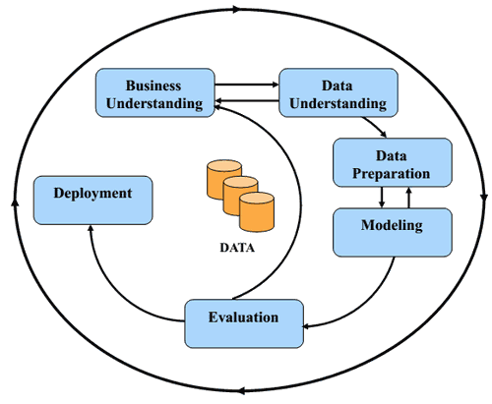
For this presentation, we will follow CRISP-DM
Notes:
Our presentation today will follow the CRISP-DM framework. First we will start with the definition of our business problem and the motivation behind our project. Next we will move to an overview of the data we used and the methods we took to prepare the data for modeling. And the final components of the presentation will focus on the modeling techniques we explored, the performance of those models, and lastly how our final model can be deployed in a business context.

Slide 3
Business Understanding

Slide 4



We are motivated by answering the following business question:
How can we use machine learning to predict the annual percentage of female representation on the board of directors of S&P 1500 American corporations?
Female board representation below 20 percent
Gender-based diversity stimulates firm success
Notes:
So the business question our project revolves around is the following: (from slide). Historically, females have comprised only a small fraction of total board members, and though the number of females on boards has generally increased over time, a large gender discrepancy still exists in most organizations. According to a statistic in 2017 from Diligent Insights, female board representation was below 20% for companies on the Russell 1000 stock index, supporting the claim that the lack of female representation on boards is still a major issue. As a result, we hope to identify specific industries that are lacking diverse board representation, as well as the primary features of organizations that contribute to low female board representation.

Slide 5
Data Understanding

Slide 6

We have used the following data sources.
Data sourced from Wharton Research Data Services (WRDS)
ExecuComp: Director Compensation
Compustat: Financial Ratios
BoardEx:
Organization Summary Analytics
107,908 observations and 107 columns
2,162 unique companies
Captures annual metrics regarding directors’ compensation and personal characteristics
Age
Gender
Location
Company headquarters
480,739 observations and 76 columns
Firms’ financial data:
Capitalization
Efficiency
Financial soundness
Solvency
Liquidity
Profitability
Valuation ratios
757,192 observations and 60 columns
Annual board-related metrics:
Directors’ tenure on their respective boards and in their respective companies,
Overall size of each director’s network
Degree of nationality
Diversity of their board
Notes:
We have found a total of three data sources (director compensation from Execucomp, financial ratios from compustat, and organization summary analytics from BoardEx) and combined it to do EDA and model building process.
First director compensation dataset contains annual metrics data related to directors’ compensation and personal characteristics (like)
Second financial ratio dataset contains firm’s financial metrics
And third organization summary analytics dataset contains annual board-related metrics

Slide 7
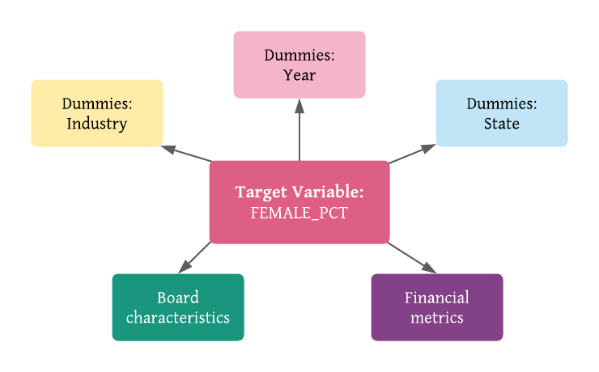
Our target variable and features are defined as:
Notes:
After merging three dataset, we have clearly defined our target variable, FEMALE_PCT, as the percentage of females on the board for each year in a given company. This metric is calculated by dividing the number of women in a board by the total number of board members in a given year for each company in the dataset.
Attributes we have used can be classified into five main categories:
We have included variables related to board characteristics such as number of board members, average salary, age, role, network size, and other related details, and we also included financial metrics of the firms (e.g., dividend payout ratio, return on assets)
Next, we have created dummy variables indicating state in which the firm is located, another set of dummy variables indicating year from which the particular observation is seen, and dummy variables indicating industry to which the firm belongs

Slide 8
Data Preparation

Slide 9
This is how we engineered the target variable
Aggregated director-level instances by company and year to get the average board characteristics and company information on company-level
Used the financial metrics from the last month of each year for each company; the year-end records present the snapshot/summary of performances of the year.
Merged the three datasets based on common keys: ‘TICKER’ and ‘YEAR’
Normalization since we used kNN and neural nets

Slide 10
This is how we engineered the features
CEO_FEMALE → Binary variable indicating whether the CEO is female or not
EXECDIR_COUNT → Number of board members who served as executive director that year
EXEC_COUNT → Number of board members
LENGTH_TERM → The length of term CEO serve
FEMALE_PCT_LAST → Last year’s percentage of female representation for each company
Notes:
CEO_FEMALE: whether the CEO is female or not
EXECDIR_COUNT: Number of board members who served as executive director that year
EXEC_COUNT: Number of board members
REJOIN: Number of board members that are rejoined members
Last year’s percentage of female representation for each company. This variable is important since most board members will serve more than one year, the percentage of female representation is highly likely to create autocorrelation issues, For doing so, we also lost our first year’s data, which leaves us with 16747 complete cases.

Slide 11
Modeling

Slide 12
Modeling Processes
Target variable → A numeric/fractional value, a percentage of female representation in each company for each year
Linear Regression → Better speed of learning and comprehensibility
Ensemble Methods → Better generalization performance
80(train)/20(test) split → Evaluate the final performance
Cross-validation with five folds → Optimize the hyperparameters of each model

Slide 13
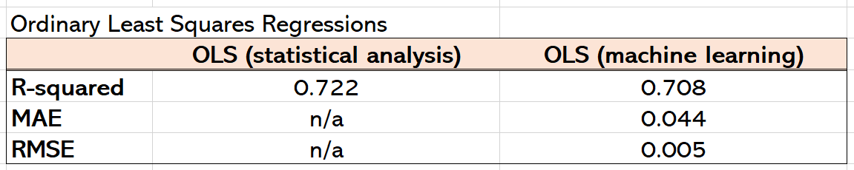
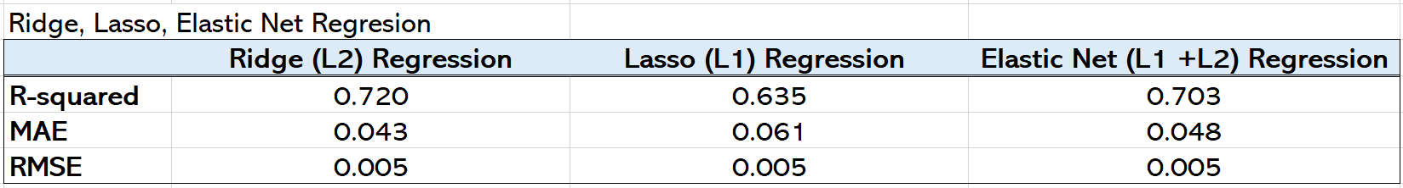
Results from Models

Slide 14
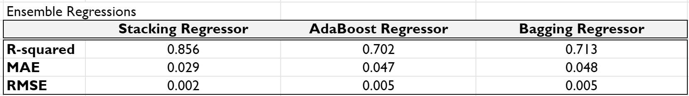
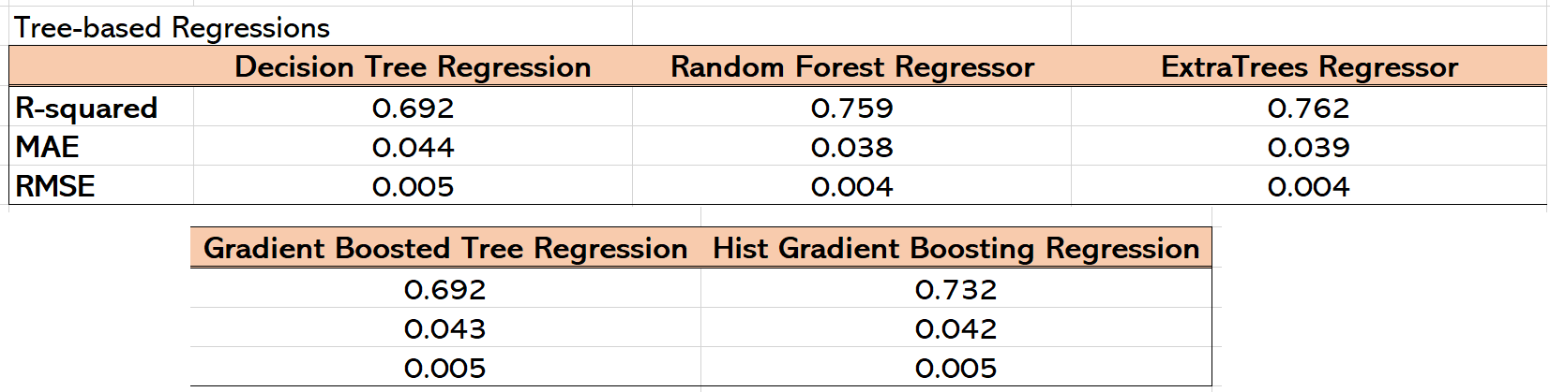
Results from Models

Slide 15
Evaluation
and Deployment

Slide 16
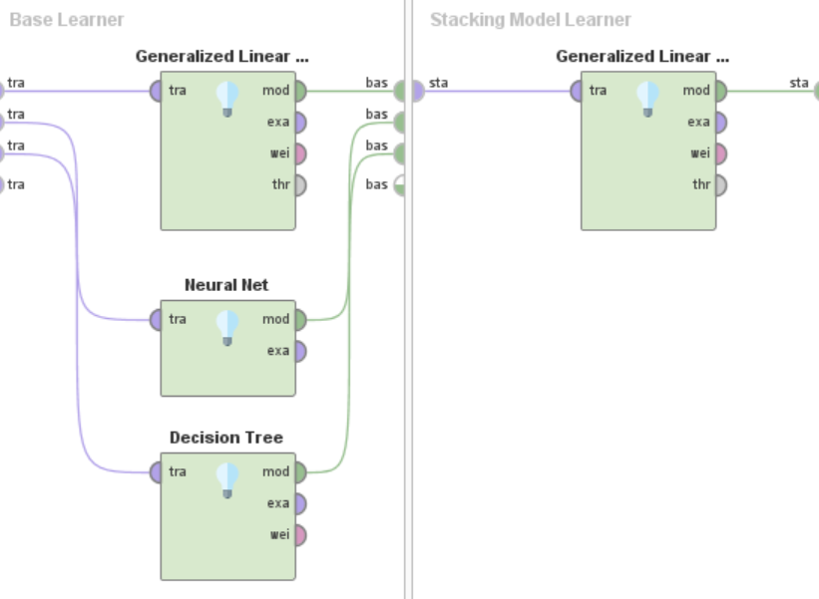
Our final model selected was a Stacking model.
Performance Metrics
R² = .856
RMSE = .051
MAE = .030

Slide 17
One deployment use case is understanding the impact of the most influential features.
 | Board Characteristics | Financial Ratios | Industries
Negative | Average Director Age Average Director Salary | High Profit Low Debt | Construction Fuel Manufacturing Technology
Positive | StDev Director Ages StDev Director Tenure Nationality Mix Network Size | Low Invested Capital Low Assets Value | Academia Consumer Goods Arts and Travel

Slide 18
Another deployment use case is using predictions to establish company gender diversity benchmarks.
Gather data
Run model
Compare prediction with actual
Set prediction as benchmark
*Data is a snapshot of the state of the company very end of the calendar year.

Slide 19
Thank you!

